Slide 1
FACE DETECTION USING AI
Submitted in the partial fulfillment for the award of the degree of
BACHELOR OF ENGINEERING
IN
INFORMATION SECURITY
Submitted by:
ANISH SHOW – 20BCS3655
UPESH KUMAR SONI- 20BCS3719
Under the Supervision of:
Ms. NEHA SHARMA
Department of AIT-CSE
DISCOVER . LEARN . EMPOWER

Slide 2
Outline
Introduction to Project
Problem Formulation
Objectives of the work
Methodology used
Results and Outputs
Conclusion
Future Scope
References

Slide 3
Introduction to Project
Face detection -- also called facial detection -- is an artificial intelligence (AI) based computer technology used to find and identify human faces in digital images. It is analogous to image detection in which the image of a person is matched bit by bit. Image matches with the image stores in database. Any facial feature changes in the database will invalidate the matching process.

Slide 4
Problem Formulation
Face detection is the first stage in face analysis, face tracking, and, most crucially, facial recognition systems, all subsequent steps. The technology is expanding at a rapid pace, and it is used in a variety of applications, including device unlocking, banking, tourism, police enforcement, building security, and others. In addition, face detection is also needed for facial recognition algorithms to recognize which parts of a picture should be used to render face prints and which parts should be ignored. These all make facial detection very important, but in which areas are face detection used and why is it important? Here are the reasons why it is essential for many spaces:

Slide 5
Methodology used
The LBPH-based algorithm, the first step is to extract the image pattern with the LBPH algorithm. Then, two thresholds are set to calculate the probability of face in the image pattern. After that, the sliding window applied to identify the faces in given images and recognize those faces.
The OpenCV method is a common method in face detection. It firstly extracts the feature images into a large sample set by extracting the face Haar features in the image and then uses the AdaBoost algorithm as the face detector.

Slide 6
Objectives of the Work
The objective of face recognition is, from the incoming image, to find a series of data of the same face in a set of training images in a database. The great difficulty is ensuring that this process is carried out in real-time, something that is not available to all biometric face recognition software providers.

Slide 7
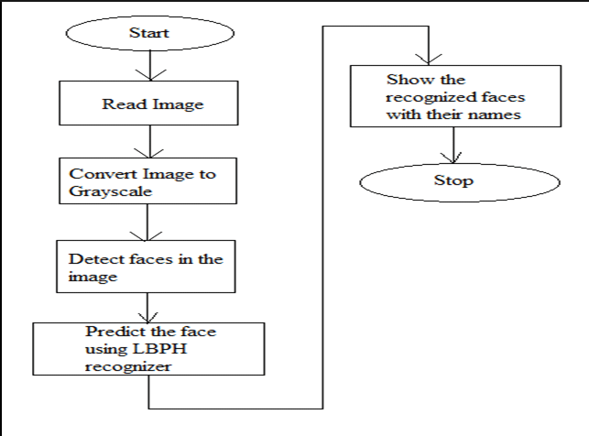
FLOWCHART

Slide 8
Results and Outputs
Face recognition system has the input in a form of an image or a video stream and the output in a form of identification or verification of the subject that appear in the image or video. There are several ways face recognition software can be designed, most of them have these three main stages: Detection. Alignment.

Slide 9
Conclusion
Face detection system is very important in our daily life. It possesses a really great advantage. It was very costly but now new technologies have evolved and the cost of equipment is going down dramatically due to the integration and the Increasing processing power. Certain applications of face detection technology are now cost effective , reliable and highly accurate.

Slide 10
Future Scope
Facial recognition systems can be used to identify people in photos, videos, or in real-time. Facial recognition is a category of biometric security. Other forms of biometric software include voice recognition, fingerprint recognition, and eye retina or iris recognition. Not only can facial recognition software and applications identify a person's image in photographs and videos, but it can also do it in real-time. From smart security cameras to digital medical applications, facial recognition software might help us in creating a safer, healthier future.

Slide 11
References
https://www.face-rec.org/interesting-papers/general/chapter_figure.pdf
https://www.slideshare.net/NiteshDubey31/project-synopsis-on-face-recognition-in-e-attendance?from_action=save

Slide 12
THANK YOU

